Slide 1
Computer Basics and Programming
By Niloufar Kashefi

Slide 2
Table of contents
01
04
02
05
03
06
Introduction
Programming
Computer Hardware
Programming Roadmap
Computer Software
Resources

Slide 3

01
Introduction

Slide 4
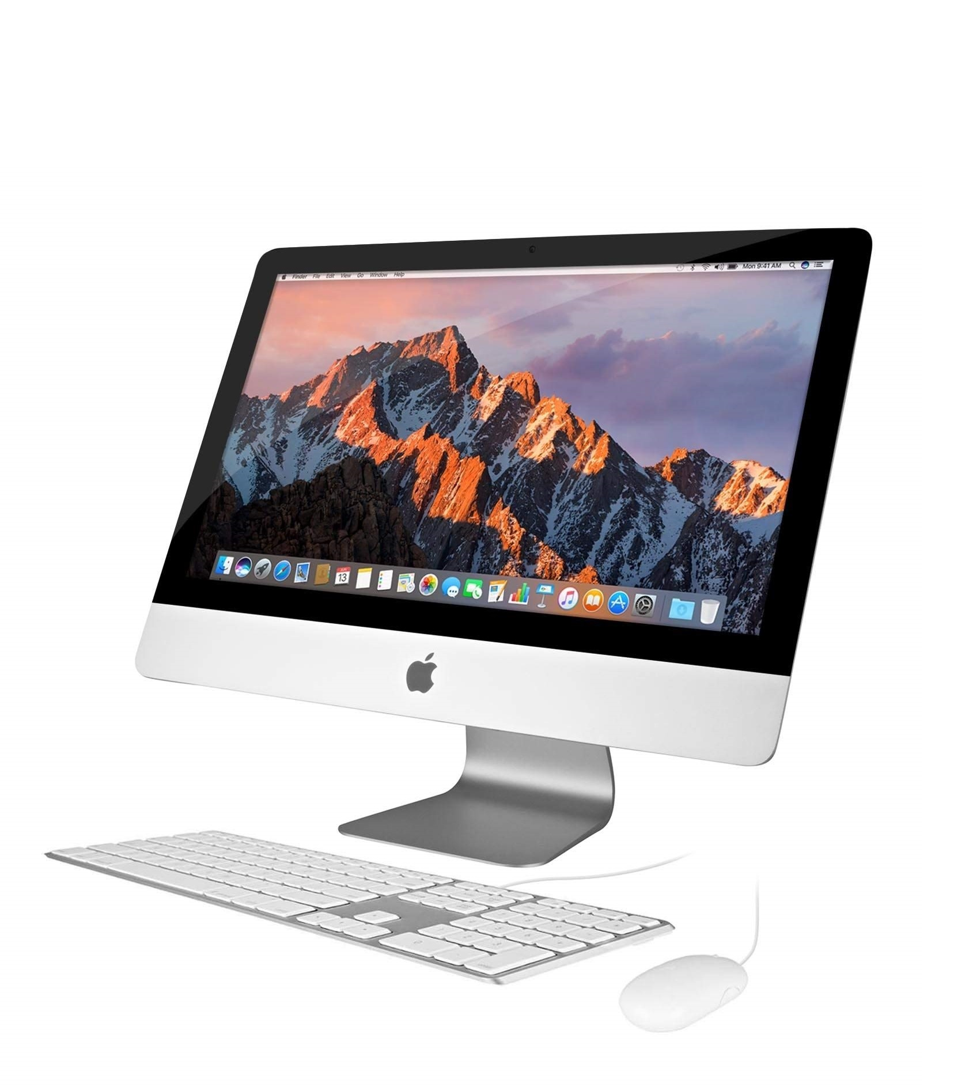
What is a Computer?
A computer is an electronic device that manipulates information, or data. It has the ability to store, retrieve, and process data. You may already know that you can use a computer to type documents, send email, play games, and browse the Web. Computers can meet human needs due to the following features:
Accuracy
Speed
Repetition
Faultless
Forgetfulness

Slide 5
Computer Parts
Computer
Hardware
Software
Input Devices
Output Devices
Control and Process
Storage Devices
IOS Application
Application Software
Keyboard, Mouse,
Mic, ….
Monitor,
Printer,
Speakers, …
CPU, CU, ALU, …
Hard Disk,
CD’s, Flash Memory, …
Windows, Linux, Mac
Office, Adobe, ...

Slide 6
User
Application software
Operation System
Hardware

Slide 7

02
Computer Hardware

Slide 8
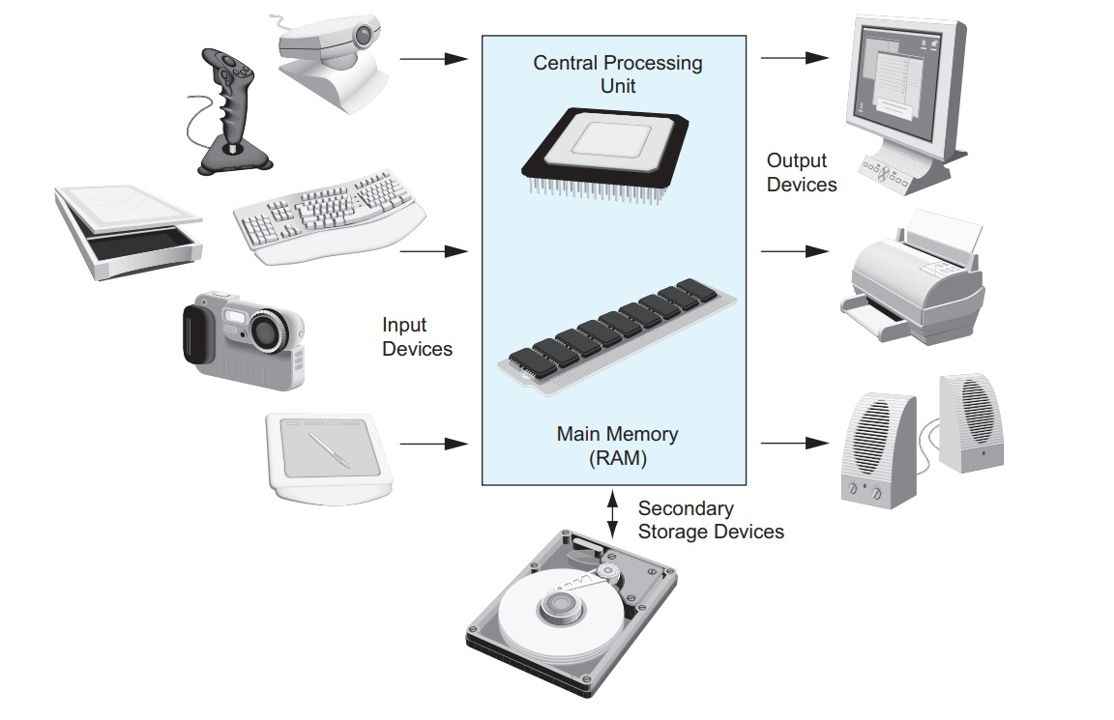

Slide 9
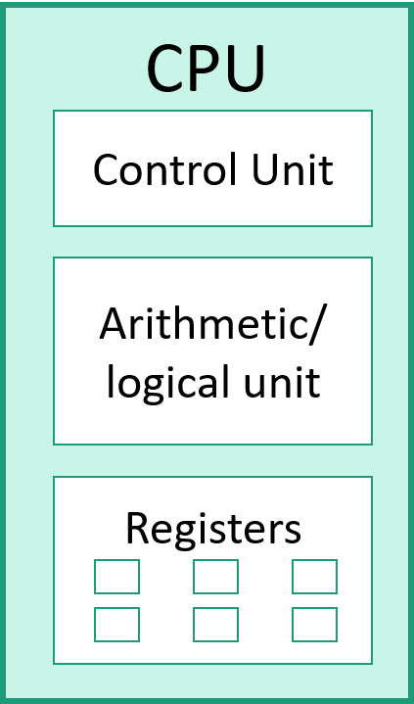

Slide 10
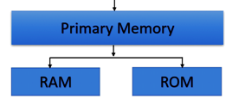

Slide 11
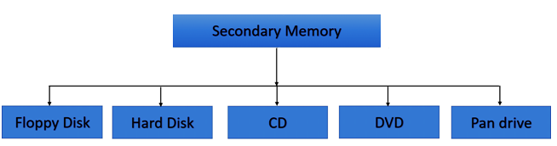

Slide 12
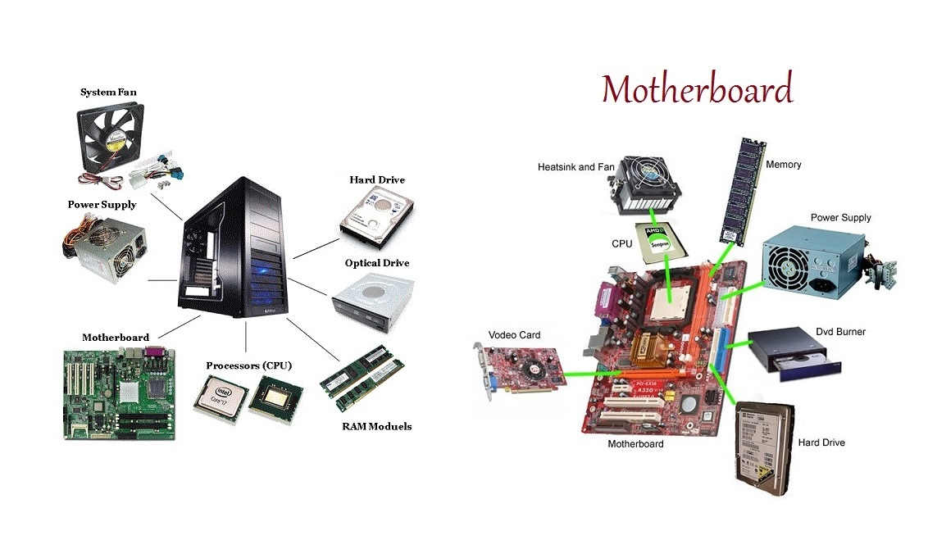

Slide 13
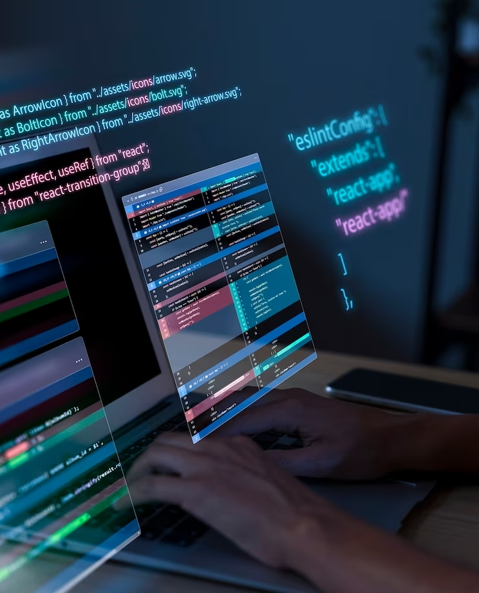
03
Computer Software

Slide 14
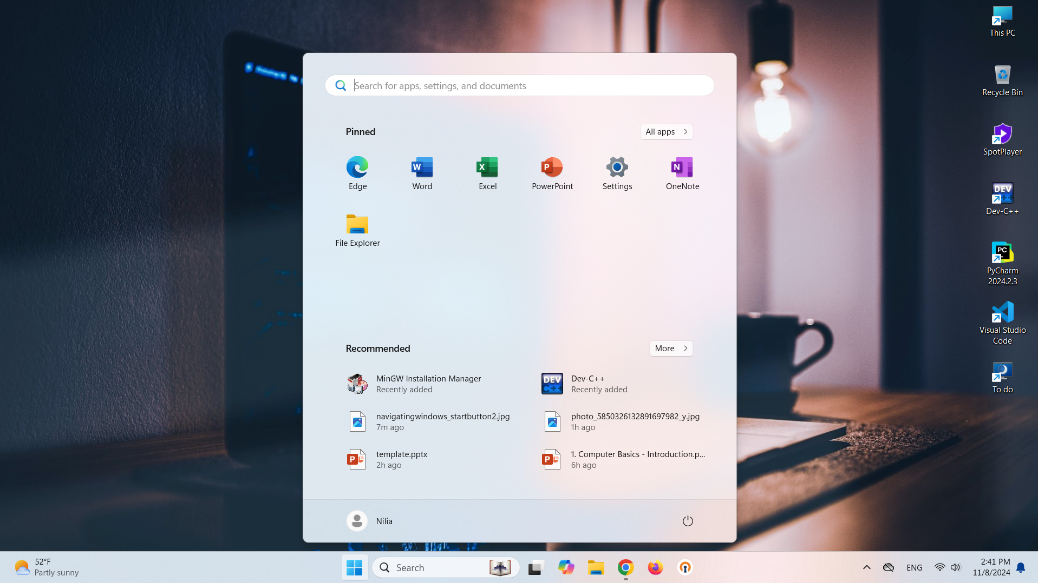
Start
Notification area
Taskbar

Slide 15
Task manager (ctrl + shift + del)
Processes: Shows active apps, background processes, Windows processes, and detailed information about CPU, RAM, data carrier, network, GPU and power levels. You can end or restart any process by right-clicking on it.
Performance: Displays a graphic showing how heavy the load on the CPU, RAM, data carrier or Wi-Fi is in real time.
App history: Shows you the resource usage history of apps in the current user account.
Startup: Displays current apps that automatically launch with every Windows 11 startup. You can also deinstall apps you’re not using to speed up Windows 11
Users: Shows all currently logged-in user accounts and their resource usage.
Details: Displays a list of all processes including name, status, CPU and description.
Services: Provides a list of all applications used for computer management. There’s a description of each app as well as information about its status, PID and application group.

Slide 16
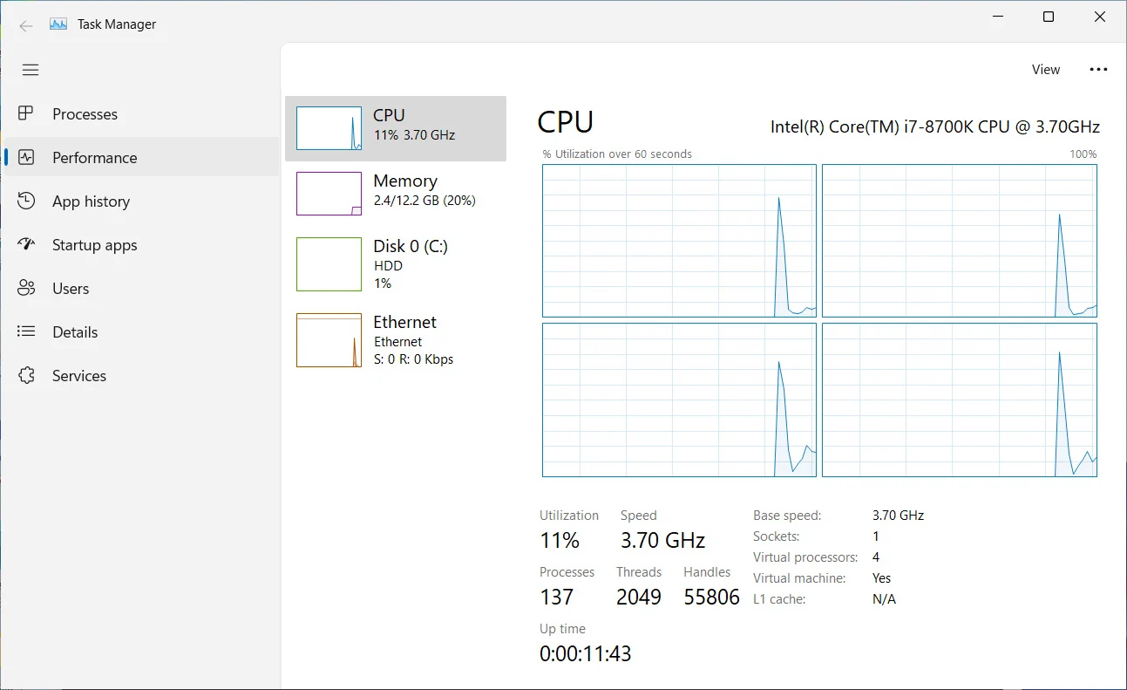

Slide 17
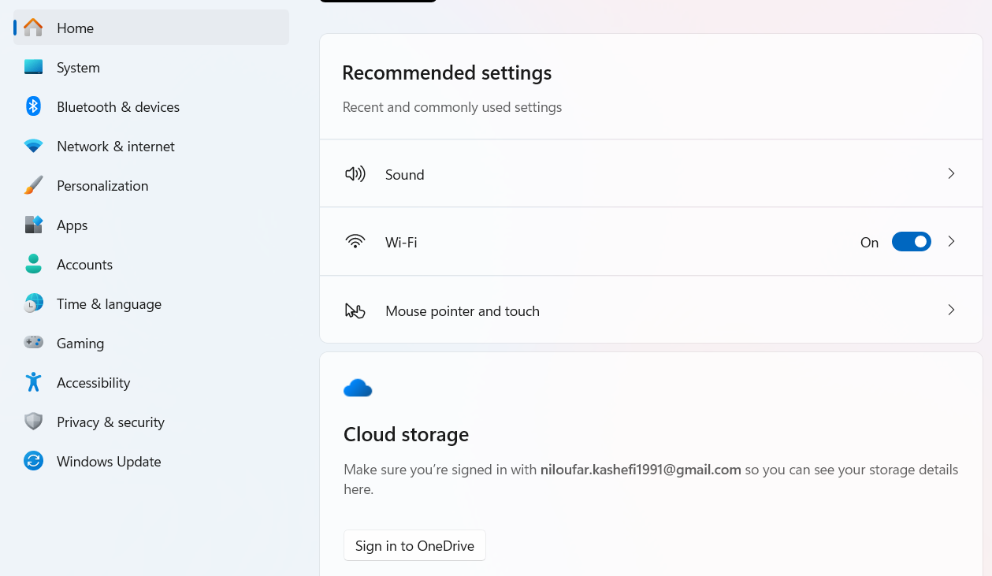
Setting ( win + i )
Settings is the main application to customize and manage Windows settings. It allows users to adjust their user preferences, configure their operating system, and manage their connected devices.

Slide 18
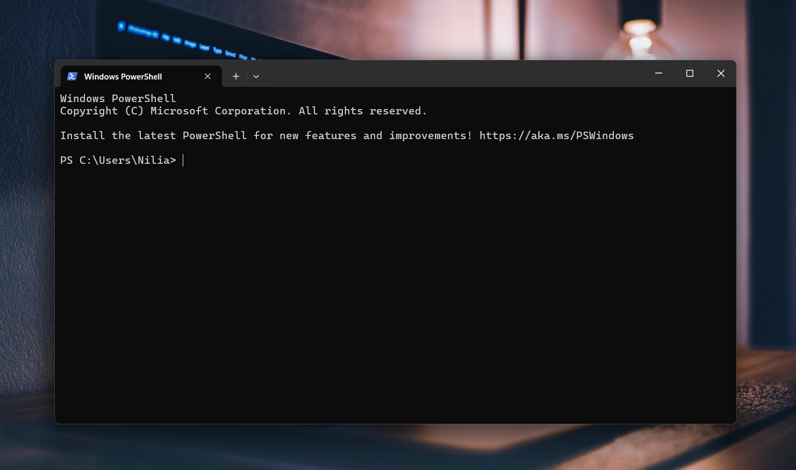
PowerShell

Slide 19
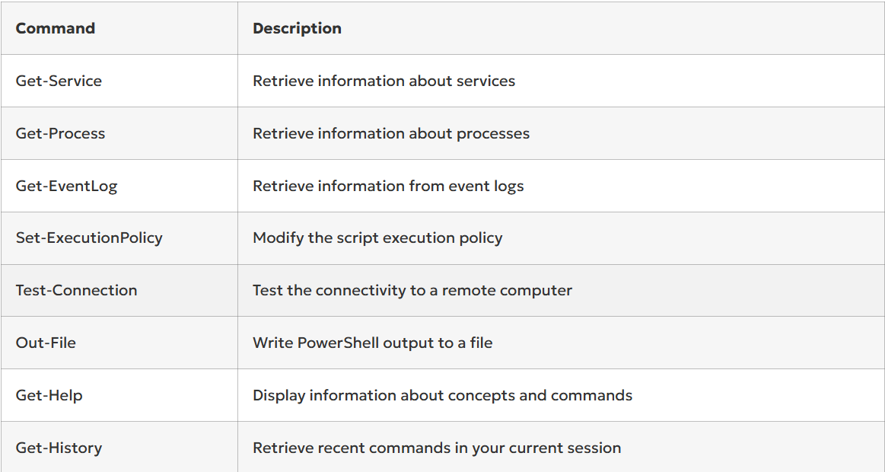
PowerShell Commands

Slide 20
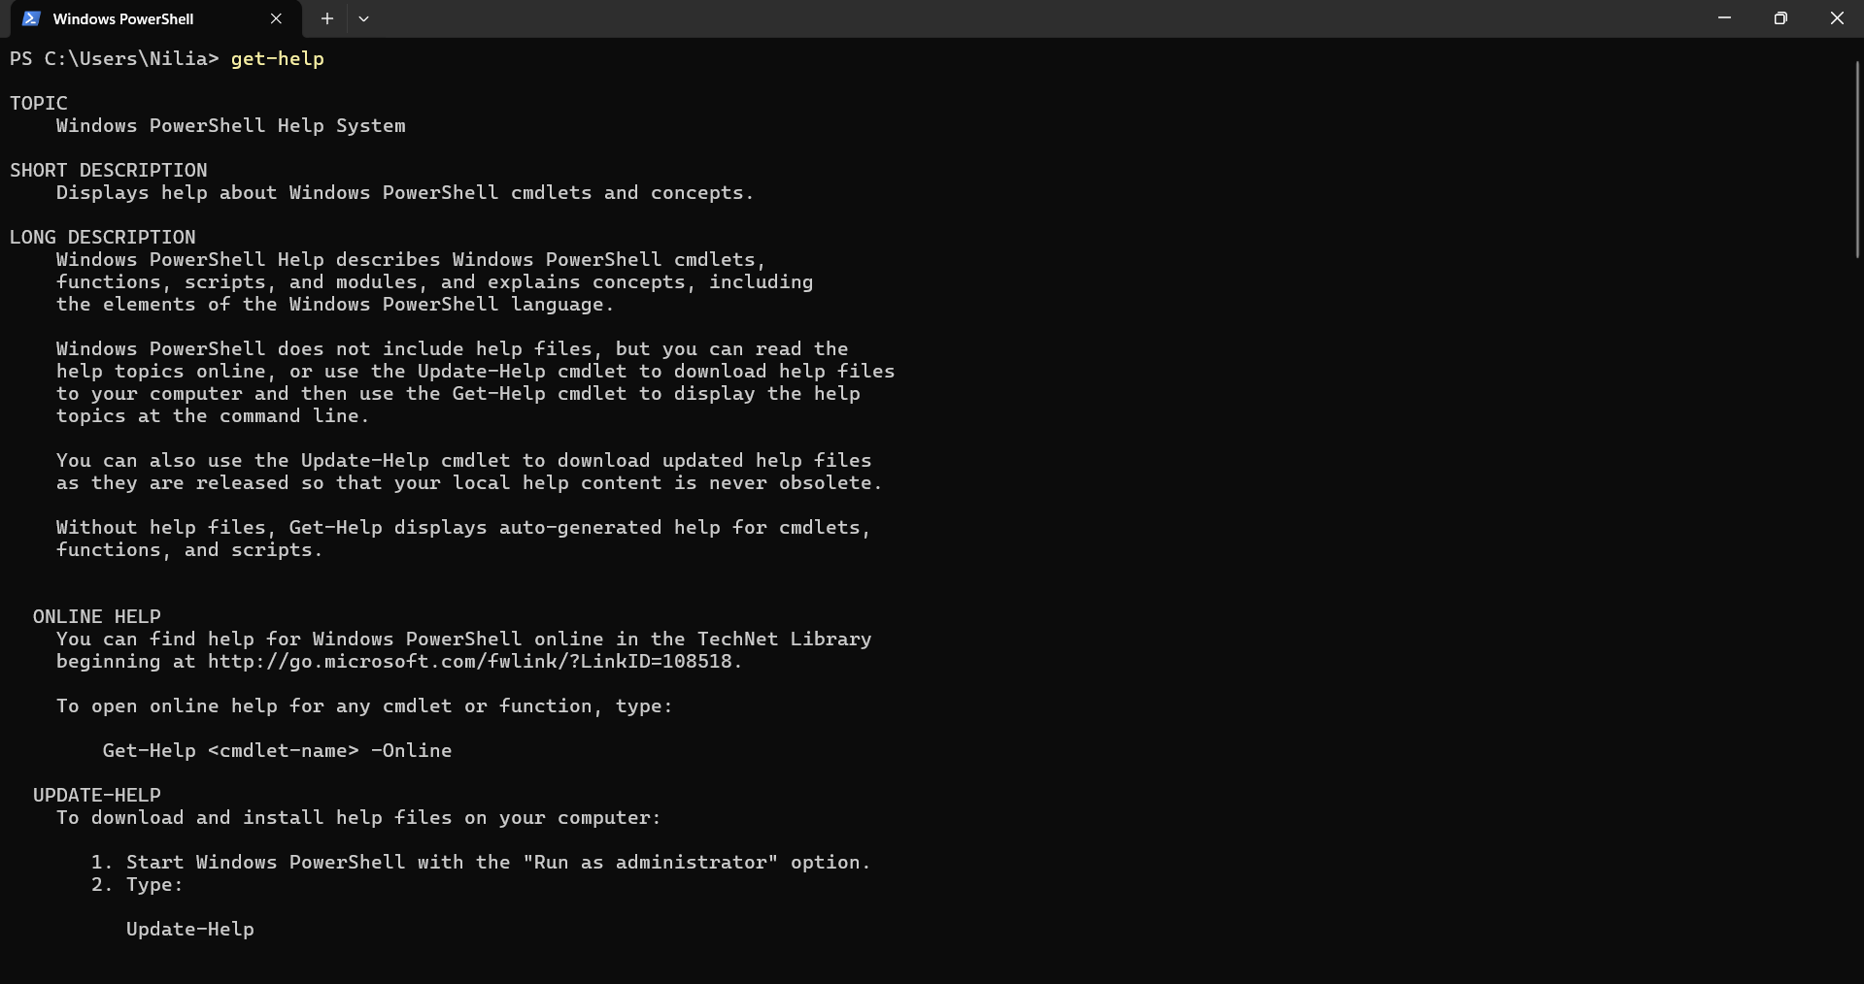
PowerShell Commands: Get-Help

Slide 21
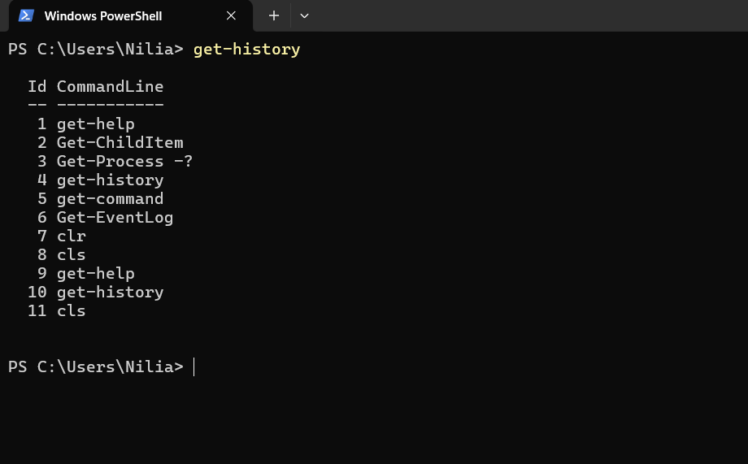
PowerShell Commands: Get-History

Slide 22
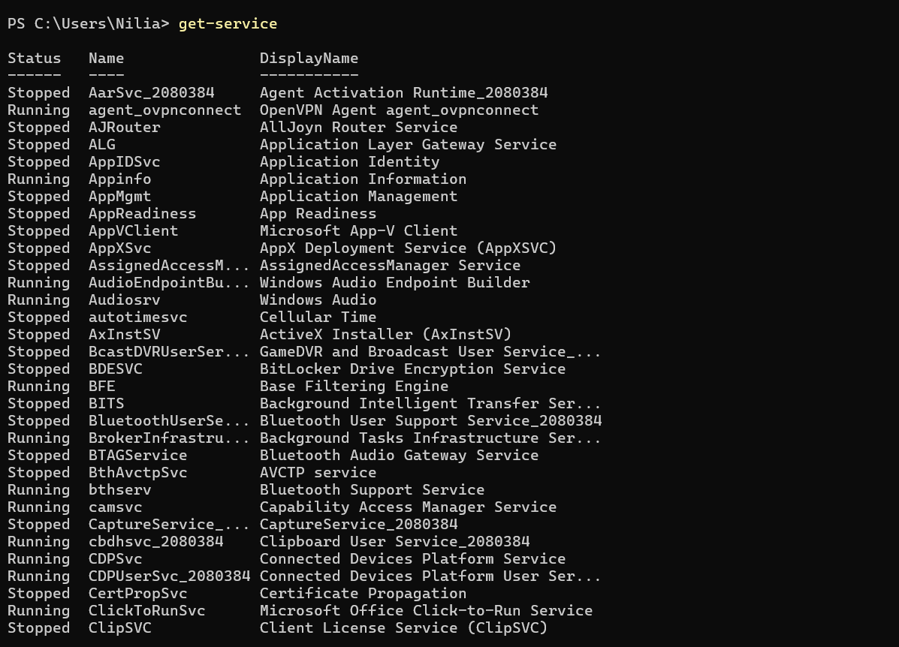
PowerShell Commands: Get-Service

Slide 23
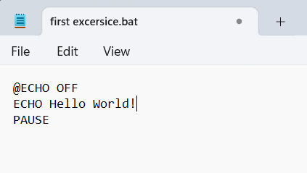
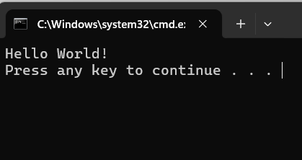
Batch file
A batch file is a type of script file commonly used in Windows operating systems. It contains a series of commands that are executed in sequence when the file is run. The steps of creating a batch file are:
Open Notepad (or any editor)
Type the following lines in the text file and save it in .bat format:
@ECHO OFF (Shows the message on a clean line disabling the display prompt)
ECHO Hello World! (Your command)
PAUSE (Allows the window to stay open after the command has been executed)

Slide 24

Application Software
Browser
Antivirous
Chrome
Firefox
ESET NOD32
KASPERSKY
Microsoft Office
Programming IDE
Word
Excel
Power Point
Visual studio code
PyCharm
PHPstorm
Adobe
Download
Photoshop
Premier
IDM (Internet Download Manager)

Slide 25
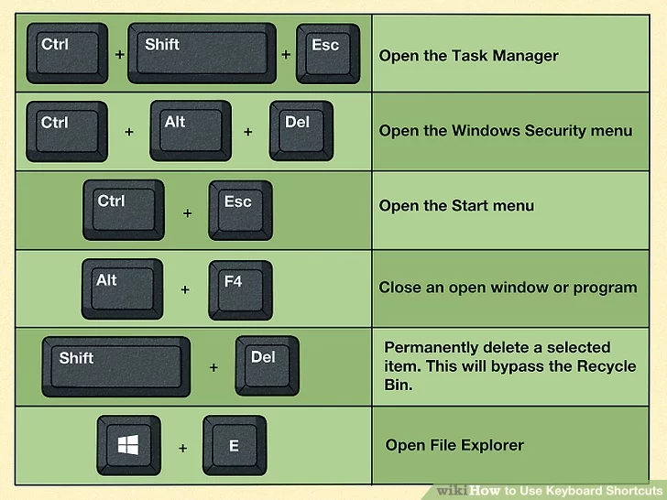
Shortcut keys

Slide 26
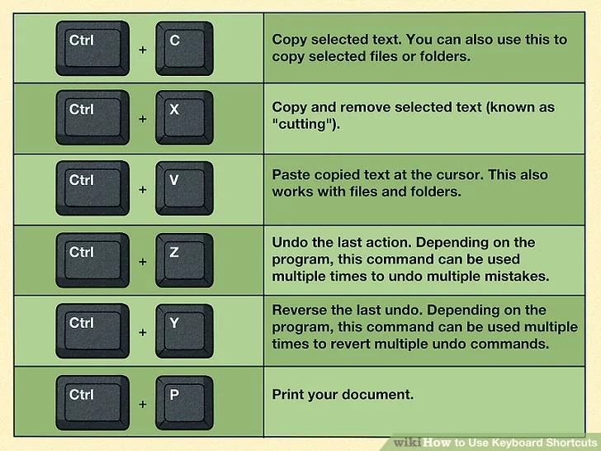
Shortcut keys

Slide 27
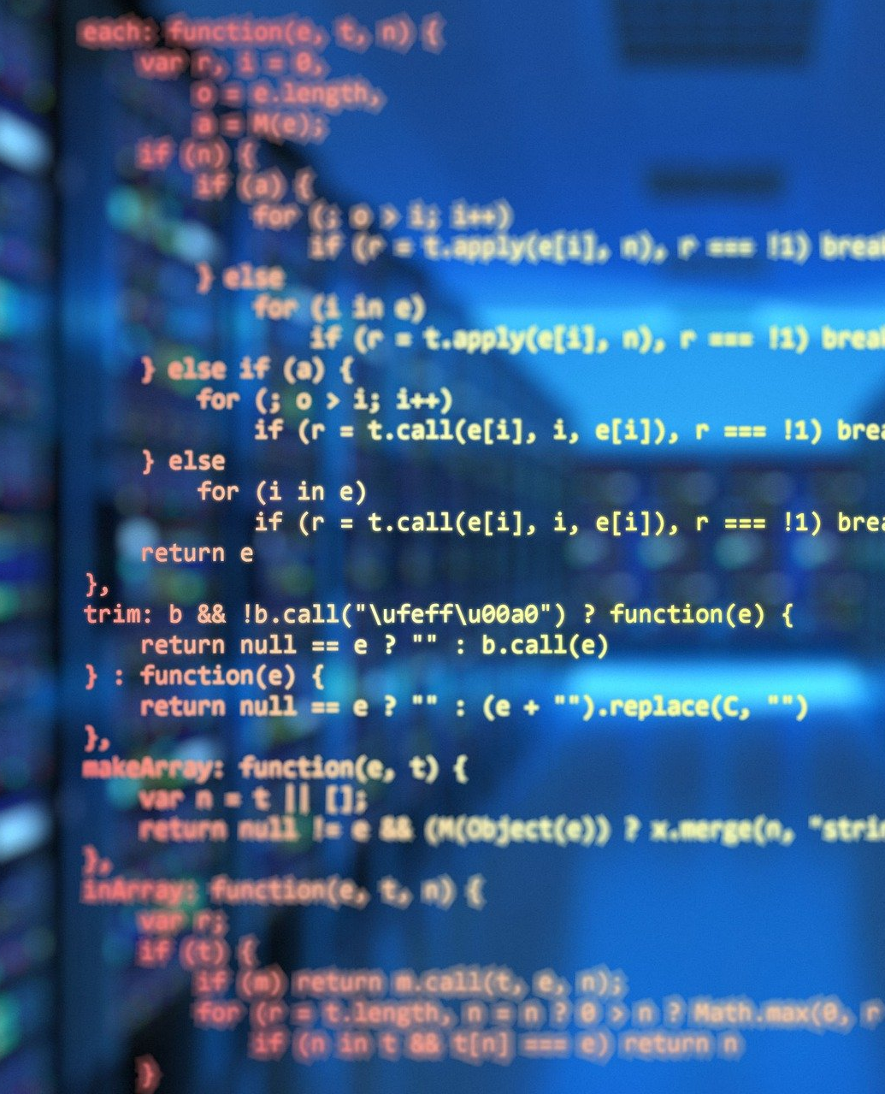
04
Programming

Slide 28
What is Programming?
01
02
03
Programming
Translate
Human Need
(Software)
Source Code
(Made By Programming)
Executable Program
(In machine Language)
Algorithm
Python, Java, C#
C++
Assembly
High Level Languages
Mid Level Languages
Low Level Languages

Slide 29

05
Programming Roadmap

Slide 30
Algorithmic mind
Search
English
Solve the problem, using algorithms
You can solve your problem by search
Self study - Search

Slide 31
Programming Roadmap:
To learn programming, you need to go through the following steps:
Structure of a Computers | I/O unit – Memory unit– CPU – CU- ALU
Computer softwares | Operation System and application softwares
Define the Problem | Including all parts of the project in detail
Algorithms | A procedure or formula used for solving a problem
Programming Structure | Variables – Operators – Program Control – Function , …
Programming Language syntax | It can be different from one language to another
Software Development Process | Solution -> Algorithm -> Code -> Test -> Document -> Installation and deployment

Slide 32

06
Resources

Slide 33
Resources
Become a programmer using these sites:
Iranian
https://faradars.org/
https://www.aparat.com/
https://maktabkhooneh.org/
Foreign
https://www.youtube.com/
https://www.udemy.com/
https://www.coursera.org/
https://www.w3schools.com/
https://www.linkedin.com/
https://stackoverflow.com/
https://github.com/

Slide 34

CREDITS: You are allowed to share this file

